Slide 1
Object-Oriented Analysis and Design
GRASP principles

Slide 2
GRASP
GRASP = General Responsibility Assignment Software Patterns (or Principles)
GRASP names and describes basic principles to assign responsibilities – useful tool for RDD
Provides patterns for assigning responsibilities
What is a pattern?
A principle or idiom used that provide guidance in the creation of software
They have a name, describe a problem, and a solution to the problem
Patterns can be applied in various circumstances, to numerous contexts
Often these guide the assignment of responsibilities to objects
A good pattern is a named and well known problem/solution pair that can be applied in new contexts
Naming is important – provides a way to identify the pattern
Good patterns are usually the result of tried-and-true knowledge, i.e. solutions that have been applied many times before

Slide 3
More on GRASP
GRASP defines 9 principles
These are basic building blocks in OOD
Creator
Controller
Information Expert
Low Coupling
High Cohesion
Polymorphism
Pure Fabrication
Indirection
Protected Variations

Slide 4
Creator
Problem: Who should be responsible for creating a new instance of some class?
Basic problem in design, so it’s a good idea to have a general principle for deciding how to solve this (i.e., how to assign this responsibility)
Solution: Assign class B the responsibility to create class A if one or more of the following is true:
B “contains” or completely aggregates A
B records A
B closely uses A
B has the initializing data for A that will be passed to A when it is created (B is an Expert with respect to creating A)
Example: Consider the Monopoly Game example. Who creates the Square object?

Slide 5
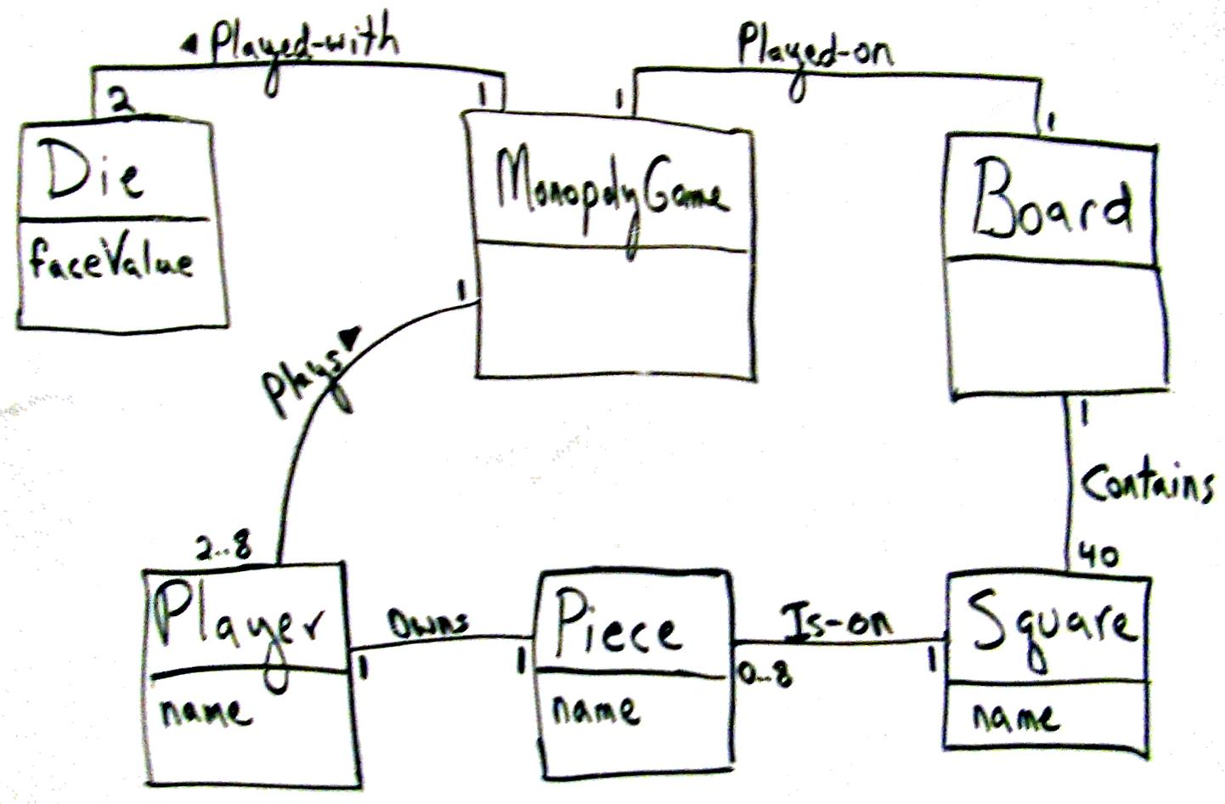

Slide 6
Creator
First, note that this is a Domain Model, not a class diagram – how do we get to the software classes?
Look to the Domain Model for inspiration on what the software objects should be
Notice that the Board conceptual class contains Squares – this suggests a software class composition
Board should create Squares, Squares are part of the Board, Board manages their creation and destruction (composition)
After reviewing the Domain Model diagram, we can conclude that a Board object would be a good creator for the Square object in our Design Model
Note we also include an interaction diagram, so we can create the dynamic object model along with the static object model

Slide 7
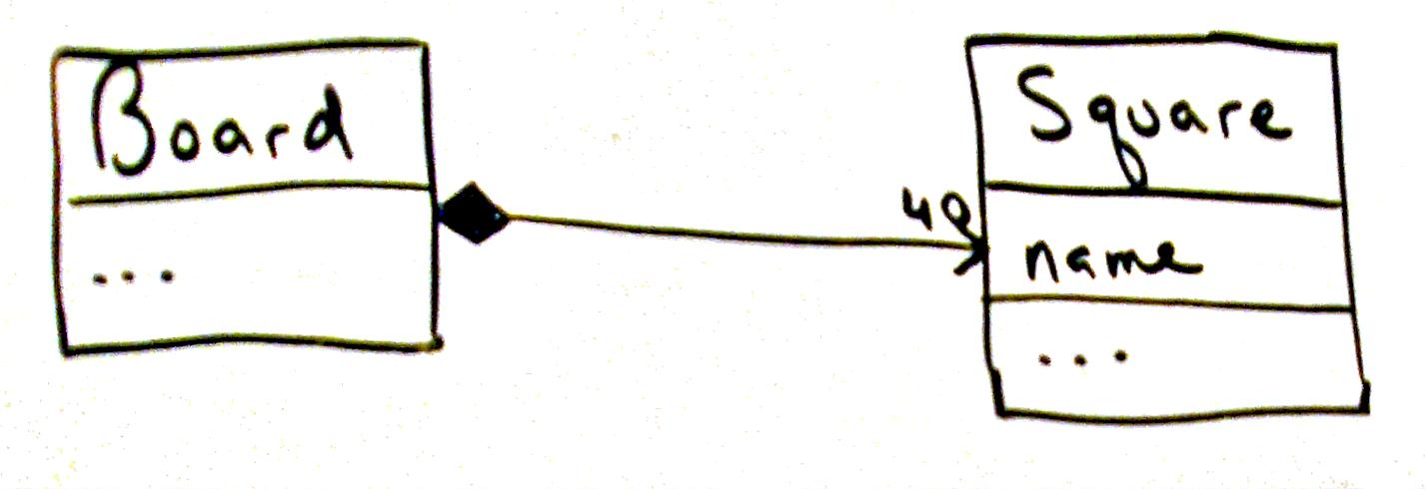
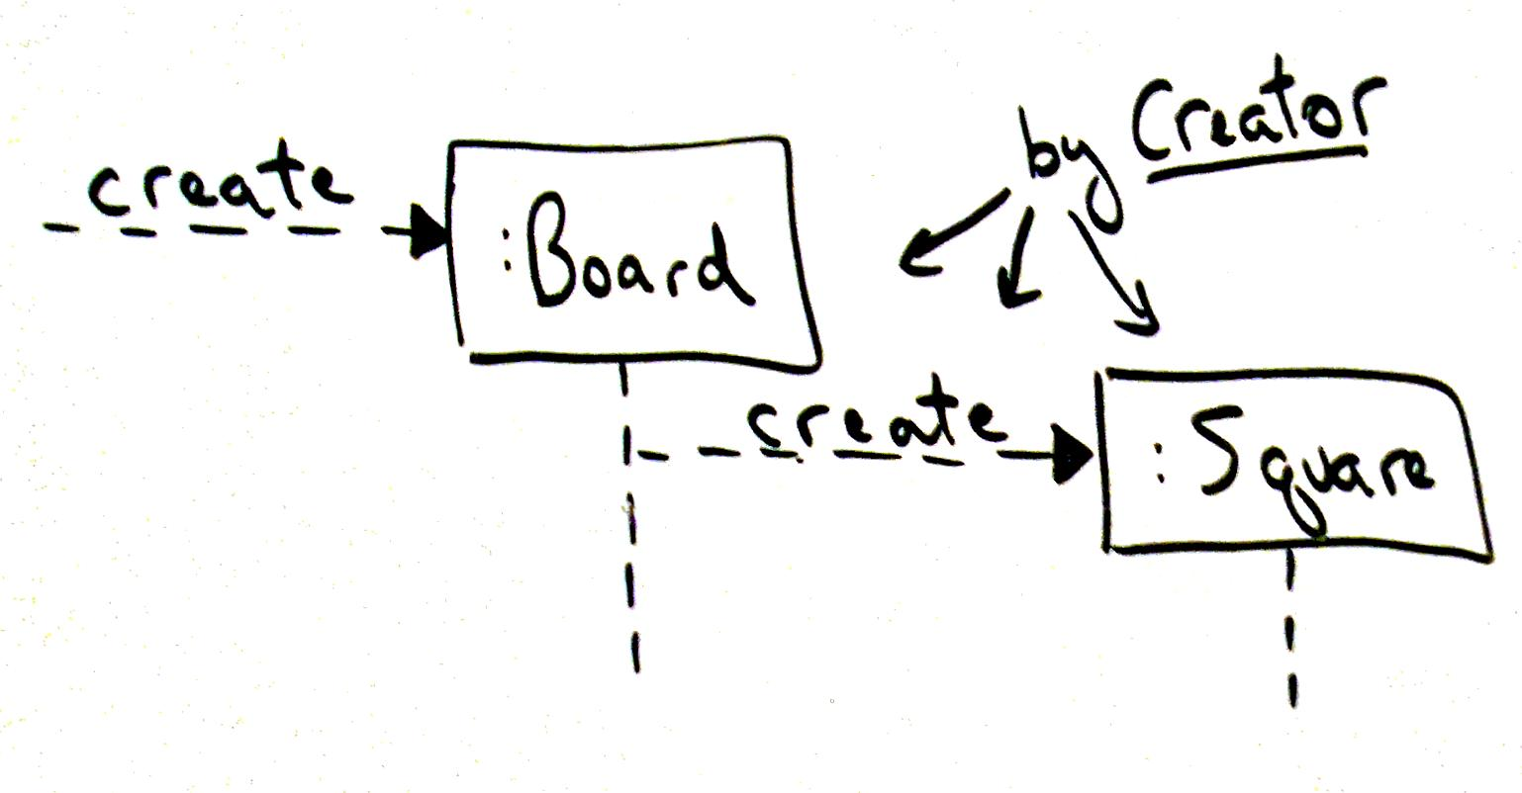

Slide 8
Information Expert
Problem: What is a basic principle for assigning responsibilities to objects?
Solution: Assign a responsibility to the class that has the information needed to fulfill it.
Example: Consider the Monopoly game. Suppose an object wants to reference an Square, given its name. Who is responsible for knowing the Square, given its name?
Most likely candidate is the Board, because it is composed of Squares
Since the Board is composed of Squares, it is the object that is best suited to produce a particular square given the square’s name – the Board is the Information Expert, it has all of the information needed to fulfill this responsibility
See the next slide for how this translates into object design …

Slide 9
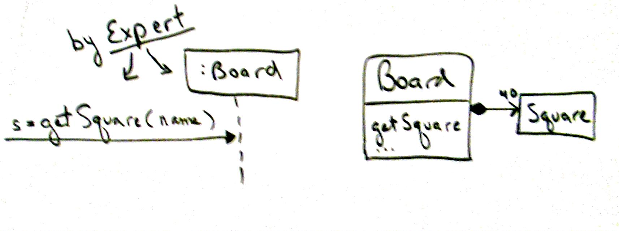

Slide 10
Low Coupling
Problem: How to support low dependency, low change impact, and increased reuse in your design?
Solution: Assign responsibilities so that coupling remains low
Coupling is a measure of how strongly one element is connected to, has knowledge of, or relies on other elements. Low coupling means less dependence on other objects
This makes sense – if a class with strong coupling is changed, it will affect many other classes, which makes for high change impact
Consider the Monopoly Game: We assigned the getSquare responsibility to the Board, because it contains the Squares. What if we assigned it to another class, like “Dog”?
Consider the following diagrams – we have increased the coupling in our design, not a good idea

Slide 11
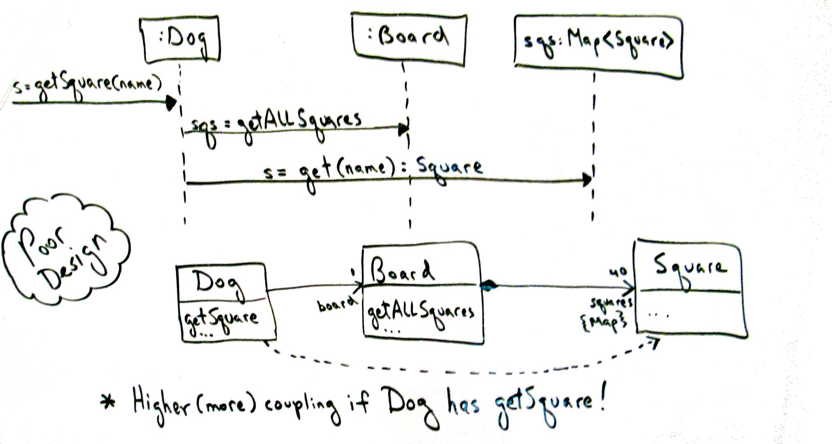

Slide 12
Low Coupling: Monopoly Example
Note this adds another layer of complexity to the design model:
First, Dog must get a list of all of the Squares from Board
Only then can it access the Square it wants to satisfy the responsibility of finding the Square instance given its name
Increased coupling – now both Dog and Board are associated with Square
Interaction diagram is a clue that this is not a good way to go …
Note that this is closely related to the Expert pattern
Usually, the Expert is the best choice to fill the responsibility, because using another object will add coupling (the alternate object choice would probably need to be associated with the expert anyway)

Slide 13
Low Coupling: Observations
Always good to reduce coupling in design decisions, but can’t be the single factor
In coding, coupling could mean:
Having an attribute that refers to an instance of another object
Calling services or methods of another object
Referring to an instance of another object in a method
Direct or indirect subclass
Using an interface
Low coupling is good – independent objects lessen impact of change

Slide 14
GRASP Patterns: Controller
Problem: What first object beyond the User Interface layer receives and coordinates (“controls”) a system operation?
Solution: Assign responsibility to a class representing one of the following choices:
Represents the overall “system”, a “root object”, a device that the software is running in, or a major subsystem (these are façade controllers)
Represents a use case scenario within which the system event occurs, often called a “Handler”, “Coordinator”, or “Session”. Use the same controller class for all system events in the same use case scenario. Note a “session” is a conversation between the system and an actor, and is often organized in terms of use cases
A Controller is the first object (beyond any User Interface object) that is responsible for receiving or handling the event and generating the operation

Slide 15
GRASP Patterns: High Cohesion
Problem: How to keep objects focused, understandable, and manageable, and as a result support Low Coupling?
Solution: Assign a responsibility so that cohesion remains high. In other words, only assign strongly related responsibilities to an object. An element with highly related responsibilities that does not do a tremendous amount of work has high cohesion.
Low cohesion classes:
Complicated, hard to understand
Hard to reuse
Hard to maintain
Brittle; easily affected by change

Slide 16
High Cohesion: Observations
High cohesion objects are useful when dealing with relational databases – design separate classes to deal with different parts of the RDB
In general, high cohesion classes usually have few methods with highly related functionality
Collaborate with other objects to accomplish tasks
Analogy: Avoid “overloading” one member of your team with too many responsibilities – distribute the workload among experts, don’t assign them unrelated activities
This is similar to “modular design”
High cohesion is related to low coupling – bad cohesion leads to bad coupling, and viceversa

Slide 17
Polymorphism
Problem: How to handle alternatives based on type? How to create pluggable software components?
Solution: When related alternatives or behaviors vary by type (or class), assign responsibilities for the behavior (using polymorphic operations) to the types for which the behavior varies.
Polymorphism: Here it means “giving the same name to services in different objects” when services are similar or related. So for example, the different objects may implement a common interface or be members of the same super-class.

Slide 18
Polymorphism: Monopoly Example
In Monopoly, there are different kinds of squares that require different behavior when landed on:
Go square – player receives $200
Income Tax square – player must pay tax amount
Go to Jail square – player goes to the Jail
Regular square – nothing new happens right now, in more detailed use case player can buy or pay rent
When designing the simulation application system, we must decide how to assign the responsibility of handling the system operation that occurs when a Player rolls the dice and lands on a square
Note that although the Player always lands on a square, there are different behaviors depending upon Square type
Avoid doing this as a “Switch” statement in the system – too rigid. Use Polymorphism.

Slide 19
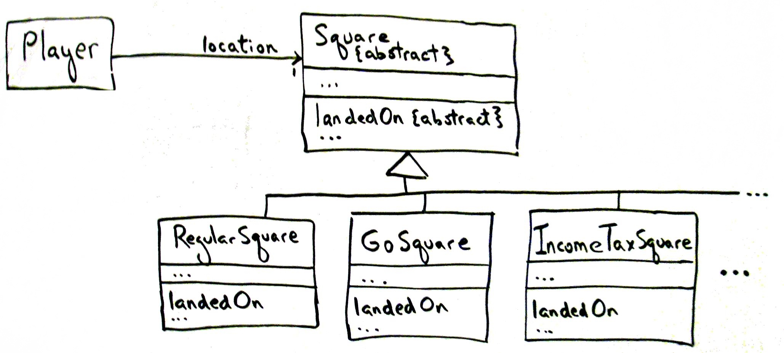

Slide 20
Polymorphism: Monopoly Example
Here we have defined an abstract Square class with an abstract method called landedOn(). We can then define subclasses for the types of Squares, and each can (using Polymorphism) define their own behaviors for the landedOn() method.
Note the Player only needs to be aware of the landedOn() method name
The Player knows the current location (Square) he/she is on, and the Player rolls the dice and gets the value
The Player can then check with the Board to get the next square, and then use the landedOn() method to initiate the behavior associated with that square.
This is better than having the Player maintain a list of behaviors for each type of square and then having the Player implement the behavior
See next slide for examples

Slide 21
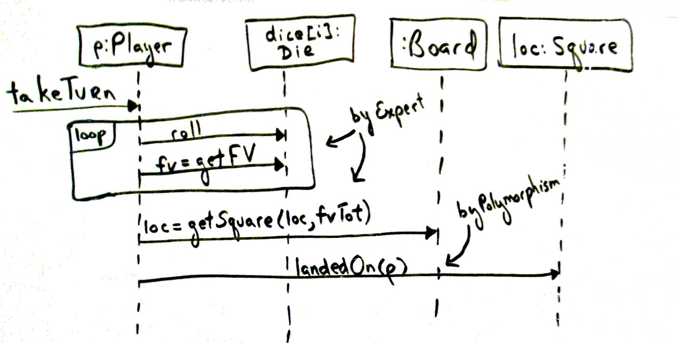

Slide 22
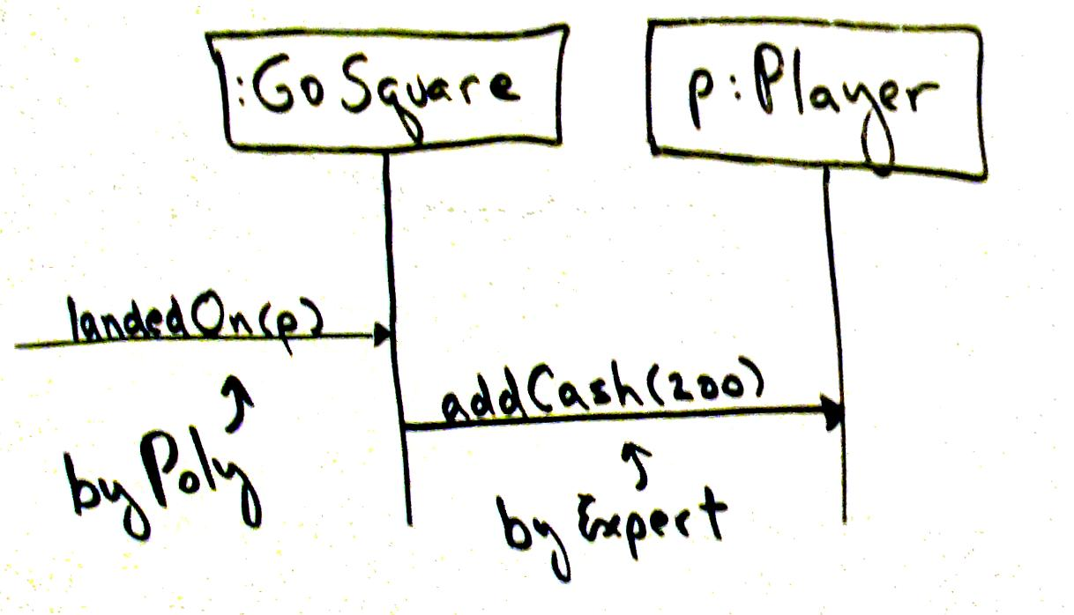
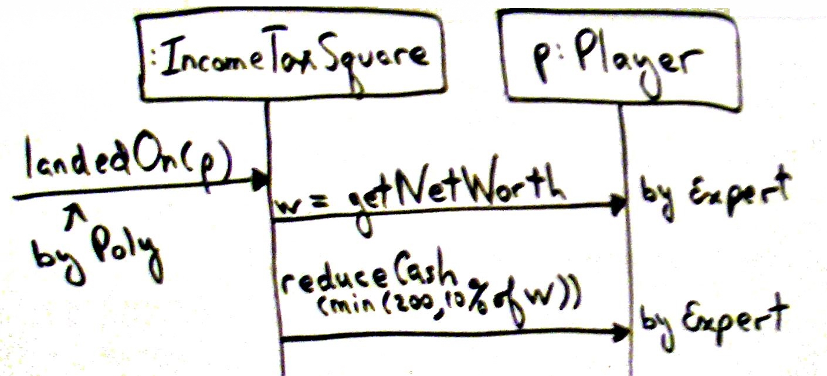

Slide 23
Polymorphism: Observations
Polymorphism is fundamental when designing a system for which a system operation may generate multiple variations of behavior (landedOn(), getTaxes())
Usually, this will result in the definition of interfaces or abstract classes
Use interfaces to support polymorphism without creating a new class hierarchy
In general, creating interfaces is more flexible, since you do not need to be a sub-class of the super-class to implement the interface

Slide 24
Pure Fabrication
Problem: If you do not want to violate High Cohesion and Low Coupling, what object should be assigned responsibility if the solutions offered by the Expert principle are not valid?
Solution: Assign a highly cohesive set of responsibilities to an artificial or convenience class that does not represent a domain conceptual class – i.e., create a new object that does not correspond to a domain object, but has high cohesion, low coupling, and is reusable.
This allows us to make up new classes that are not implied by (or directly associated with) the Domain Model
Often useful to collect responsibilities which simply cannot be assigned to existing objects in a good (high cohesion, low coupling) way

Slide 25
Pure Fabrication: Monopoly Example
Currently, the Player rolls the dice (once for each die), gets the face value as a result of each roll, and computes the total
Somewhat complicates the Player object, and the Dice object is not very reusable
Can use Pure Fabrication to create a new class, Cup
The Cup will be associated with the Dice object, and the Player will request that the Cup roll the dice and return the total
The class Cup can be designed so that on instantiation the total number of die is set
This class may then be used by other game systems, as is.
See the next slide for Design Model diagrams

Slide 26
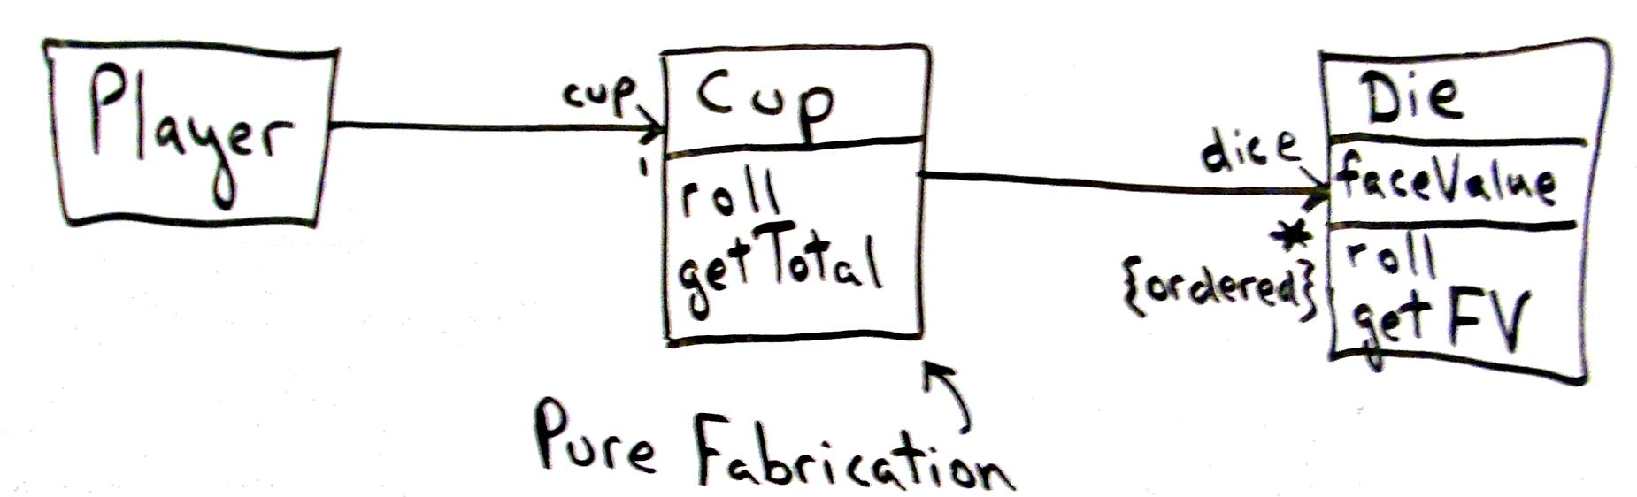
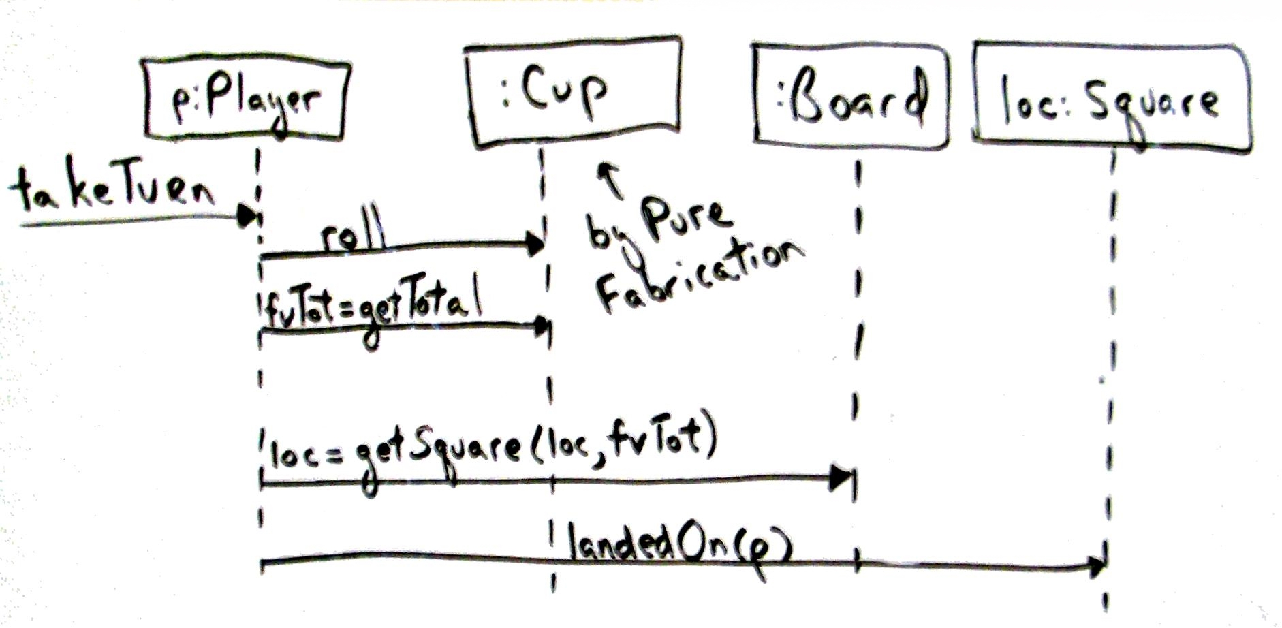

Slide 27
Indirection
Problem: Where to assign a responsibility to avoid a direct coupling between two (or more) things? How to de-couple objects so that low coupling is supported and reuse potential remains high?
Solution: Assign the responsibility to an intermediate object to mediate between other components or services so that they are not directly coupled.
This is very related to Polymorphism and Pure Fabrication
Essentially, create a “go between” or mediator class to insulate (protect) the “inner” design from external elements which may change
The same database example we used for Pure Fabrication would also be an example of Indirection (see next slide)

Slide 28
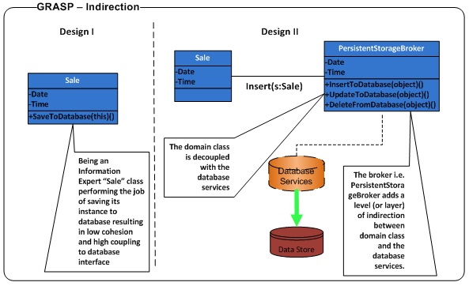

Slide 29
Protected Variations
Problem: How to design objects, subsystems, and systems so that the variations or instability in these elements does not have an undesirable impact on other elements?
Solution: Identify points of predicted variation or instability, assign responsibilities to create a stable interface around them
One example: The “Don’t talk to strangers” principle, which states that an object’s methods should only send messages (i.e. use methods) of objects that it is directly familiar with
Avoid a “chain” of method calls (foo.getA().getB().getC().getD()), because this traverses along the path of object connections to send a message to a distant object.
Dangerous because of the possibility of change along the chain, which could easily break this design (further along you go, more likely something will change and so break)
Related to Indirection, Polymorphism (the Tax Calculator example shows Indirection)

Slide 30
GRASP: Final Thoughts
Note that these are principles of OOD – they are not templates or recipes
Sometimes, the principles contradict each other – as a designer, you need to discover the best approach
Reuse is always a strong motivator, but there are exceptions

